Slide 1

Sleep tracking band
A PROJECT REPORT
Submitted By
Sagar Vyanjane(210305111029)
Ujwal Mukkawar(210305111028)
Jenil Naik(2103051110 )
Piyush Suthar(210305111027)
In partial fulfilment for the award of the degree of
BIOMEDICAL ENGINEERING
Under the guidance of
Prof. Dimpal Khambhati
Parul University, Waghodia, Vadodara

Slide 2

CERTIFICATE
This is to certify that Sagar Vyanjane ,Jenil naik ,Ujwal mukkawar and Piyush suthar from department of Biomedical Engineering with the subject code 203111354 has successfully completed their project on “ sleep tracking band”, during the academic year 2023-2024.
Date of submission
Staff in charge

Slide 3
ACKNOWLEDGEMENT
On this great occasion of accomplishment of our project on sleep tracking band (project name), we would like to sincerely express our gratitude to Prof. Dimpal Khambhati, Head of Department of Biomedical Engineering who has been supported through the completion of this project. We would also be thankful to our institute Parul University for providing all the required facilities in completion of this project. Finally, as team members, we would like to appreciate all group members for their support and coordination, I hope we will achieve more in our future endeavours.
Regards
Sagar Vyajane
Ujwal Mukkawar
Jenil Naik
Piyush Suthar

Slide 4
ABSTRACT
The rapid pace of modern life has significantly impacted the quality and duration of sleep for many individuals, leading to various health issues and decreased overall well-being. In response to this growing concern, this project introduces a novel sleep tracking device designed to monitor and analyze sleep patterns accurately and conveniently. The device employs advanced sensor technology to gather comprehensive data regarding an individual's sleep cycles, movements, and environmental factors such as room temperature and ambient noise levels.
The primary objective of this project is to develop a reliable and user-friendly device capable of providing actionable insights into sleep quality and facilitating improvements in sleep hygiene. Through the integration of machine learning algorithms, the device interprets the collected data to generate personalized recommendations for optimizing sleep habits and enhancing overall sleep quality.
Key features of the sleep tracking device include real-time monitoring capabilities, intuitive data visualization through a companion mobile application, and seamless integration with popular health and fitness platforms. Additionally, the device prioritizes user privacy and data security through robust encryption protocols and anonymization techniques.
The effectiveness of the sleep tracking device is evaluated through comprehensive testing procedures, including comparative analyses with existing sleep monitoring technologies and user feedback surveys. The results demonstrate the device's accuracy, reliability, and effectiveness in promoting healthier sleep habits.
Overall, this project contributes to the advancement of sleep monitoring technology by introducing a versatile and accessible solution for individuals seeking to optimize their sleep quality and overall well-being. The integration of advanced sensor technology and machine learning algorithms holds promise for addressing the growing prevalence of sleep-related issues in modern society.

Slide 5
TABLE OF CONTENTS
Chapter .1 Introduction
Aim
Statement of Research Problem
Justification of Problem
6
7
7
8
9
11
12
12
12
12
15
15
Chapter .2 Literature Review Chapter .3 Proposed Project
Block Diagram
Methodology
Requirements
Hardware
Software
4. Working Principle
Chapter .4 Conclusion References
CONCLUSION
18
19

Slide 6
Chapter 1
Introduction
In today's fast-paced society, the importance of quality sleep cannot be overstated. Yet, with the constant demands of work, social engagements, and digital distractions, achieving restful and rejuvenating sleep has become increasingly elusive for many individuals.
The repercussions of inadequate sleep extend far beyond mere fatigue, impacting cognitive function, emotional well-being, and overall physical health.
Recognizing this pervasive issue, there is a pressing need for innovative solutions to help individuals understand, monitor, and improve their sleep patterns.
This project aims to address this need through the development of a sophisticated sleep tracking device. Leveraging advancements in sensor technology and machine learning algorithms, the device offers a comprehensive solution for monitoring sleep quality and providing actionable insights for optimizing sleep habits. By accurately capturing data on sleep duration, cycles, and environmental influences, the device empowers users to make informed decisions to enhance their sleep hygiene and overall well-being.

Slide 7
Aim
The primary aim of this project is to design, develop, and evaluate a novel sleep tracking device that accurately monitors sleep patterns, analyzes sleep quality, and provides personalized recommendations for optimizing sleep hygiene. Specifically, the project aims to achieve the following objectives:
Design and developement
Integration of machine learning algorithms
Testing and evaluation
Privacy and security consideration
by achieving these objectives, the project aims to contribute to the advancement of sleep monitoring technology and empower individuals to take proactive steps towards improving their sleep health and overall well-being
Statement of Research Problem
Despite the widely acknowledged importance of quality sleep for overall health and well-being, many individuals struggle to accurately monitor and understand their sleep patterns. Existing sleep tracking technologies often lack the precision, convenience, and usability required to provide actionable
insights for optimizing sleep hygiene effectively. Moreover, concerns regarding data accuracy, privacy, and user experience
pose significant barriers effectiveness
to widespread adoption and
7

Slide 8
1.3 Justification of Problem
The justification of the research problem lies in its potential to address a significant public health concern, improve health outcomes, enhance productivity and performance, and fill a critical gap in the market for effective sleep monitoring solutions. By developing an advanced sleep tracking device capable of accurately monitoring sleep patterns and delivering personalized interventions, this research has the potential to make a meaningful impact on individuals' health and well-being.

Slide 9
Research Design:
This study adopts a mixed-methods approach, combining quantitative data collection with qualitative user feedback. The research design encompasses both laboratory-based experiments and field studies to evaluate the accuracy, reliability, and usability of the sleep tracking device in real-world settings.
Participants:
Participants for the study will be recruited from diverse demographic backgrounds to ensure the generalizability of findings. Inclusion criteria include adults aged 18 and above who have regular access to smartphones and are willing to participate in sleep monitoring activities. Participants with diagnosed sleep disorders or medical conditions affecting sleep will be excluded from the study.
Laboratory-Based Experiments:
Participants will be invited to spend one or more nights in a controlled laboratory setting equipped with polysomnography (PSG) equipment for comparison with the sleep tracking device. Sleep parameters such as sleep duration, sleep efficiency, and sleep stages will be recorded simultaneously using both PSG and the sleep tracking device.
Field Studies:
Participants will be provided with the sleep tracking device to use in their home environment for a period of at least one week.
Sleep data collected by the device, including sleep duration, sleep quality, and environmental factors, will be analyzed to assess its accuracy and reliability compared to laboratory-based PSG measurements.
Participants will be asked to provide qualitative feedback on their experience with the device, including ease of use, comfort, and perceived usefulness.

Slide 10
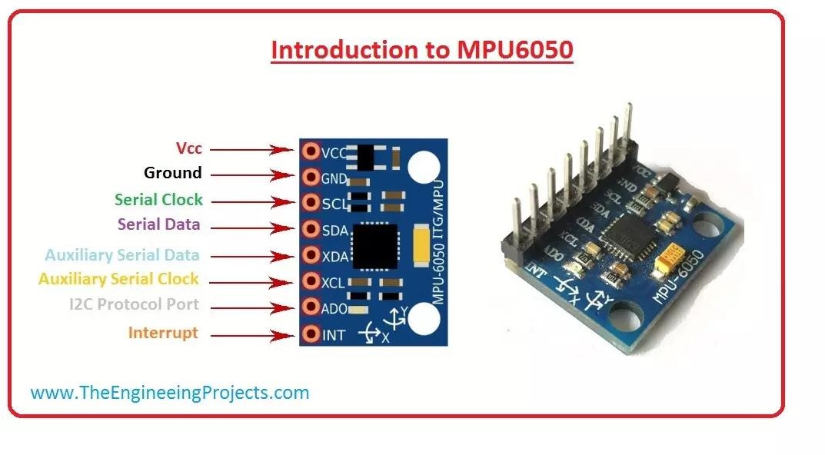
3.3 Requirements
Hardware
01 : MPU 6050
The MPU-6050 devices combine a 3-axis gyroscope and a 3- axis accelerometer on the same silicon die, together with an onboard Digital Motion Processor™ (DMP™), which processes complex 6-axis MotionFusion algorithms.

Slide 11
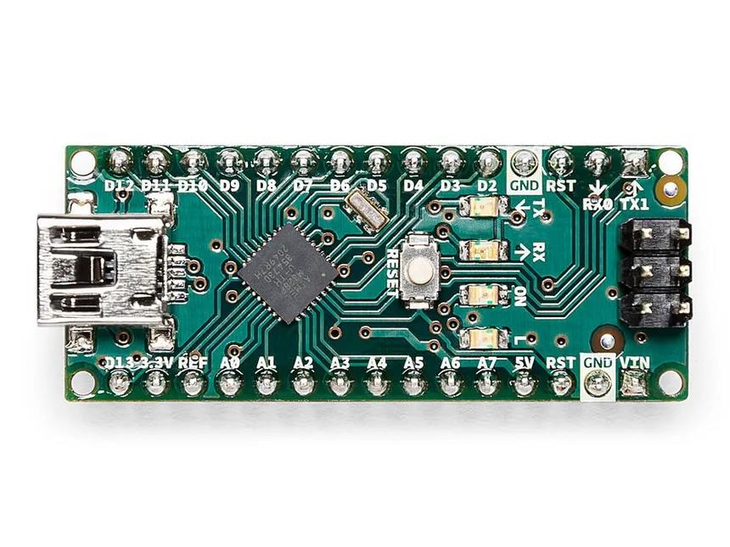
2. Arduino nano
The Arduino Nano is an open-source breadboard-friendly microcontroller board based on the Microchip ATmega328P microcontroller (MCU) and developed by Arduino.cc and initially released in 2008. It offers the same connectivity and specs of the Arduino Uno board in a smaller form factor.
The Arduino Nano is equipped with 30 male I/O headers, in a DIP-30-like configuration, which can be programmed using the Arduino Software integrated development environment (IDE), which is common to all Arduino boards and running both online and offline. The board can be powered through a type-B mini- USB cable or from a 9 V battery.

Slide 12
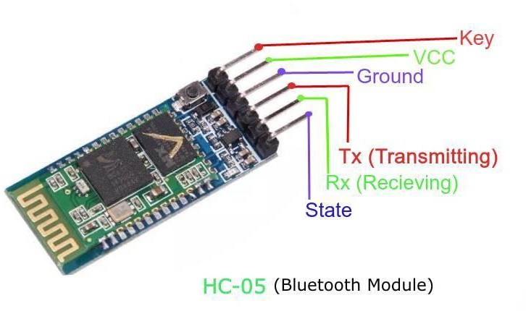
03.HC-05 Bluetooth module :
The HC-05 is a class 2 Bluetooth module designed for transparent wireless serial communication. It is pre-configured as a slave Bluetooth device. Once it is paired to a master Bluetooth device such as PC, smart phones and tablet, its operation becomes transparent to the user. All data received through the serial input is immediately transmitted over the air. When the module receives wireless data, it is sent out through the serial interface exactly at it is received. No user code specific to the Bluetooth module is needed at all in the user microcontroller program.
The HC-05 supports two work modes: Command and Data mode. The work mode of the HC-05 can be switched by the onboard push button. The HC-05 is put in Command mode if the push button is activated. In Command mode, user can change the system parameters (e.g. pin code, baud rate, etc) using host controller itself of a PC running terminal software using a serial to TTL converter. Any changes made to system parameters will be retained even after power is removed. Power cycle the HC-05 will set it back to Data Mode. Transp¹a² rent UART data transfer with a connected remote device occurs only while in Data Mode.

Slide 13

Software
1.Arduino IDE
The Arduino Software (IDE) makes it easy to write code and upload it to the board offline. We recommend it for users with poor or no internet connection. This software can be used with any Arduino board.
There are currently two versions of the Arduino IDE, one is the IDE 1.x.x and the other is IDE 2.x. The IDE 2.x is new major release that is faster and even more powerful to the IDE 1.x.x. In addition to a more modern editor and a more responsive interface it includes advanced features to help users with their coding and debugging.
[Fig 3.3c Arduino software]
The Arduino Integrated Development Environment - or Arduino Software (IDE) - connects to the Arduino boards to upload programs and communicate with them. Programs written using Arduino Software (IDE) are called sketches. These sketches are written in the text editor and are saved with the file extension .ino.
3.4 Working Principle
The sleep tracking band integrates an MPU6050 sensor, which is a gyroscope and accelerometer module. This sensor is capable of detecting motion and orientation changes.

Slide 14
Sleep Detection Algorithm:The band utilizes a sleep detection algorithm based on the motion data obtained from the MPU6050 sensor. When the user wears the band and goes to sleep, the sensor continuously monitors their hand movements. Based on the absence or presence of hand movements, the algorithm categorizes the sleep stages into "deep sleep" and "light sleep.“
Sleep Stage Classification: During deep sleep, the user's hand movements are minimal or absent for a prolonged period, indicating a state of deep rest. In contrast, during light sleep, there may be occasional hand movements or changes in position, suggesting a less restful sleep state.
Data Logging and Analysis: The band logs the duration of deep sleep, light sleep, and total sleep over time. This data can be analyzed to provide insights into the user's sleep patterns, such as sleep quality, duration, and interruptions.
Bluetooth Communication: The band communicates with a mobile app via Bluetooth (using the HC-05 module) to transmit sleep tracking data in real-time. The mobile app receives the data and displays it to the user in an understandable format, allowing them to monitor their sleep patterns .

Slide 15
Code description :
#include <SoftwareSerial.h>
#include <MPU6050_tockn.h> #include <Wire.h>
MPU6050 mpu6050(Wire);
SoftwareSerial MySerial(7, 8); // pin 7 connects to TX of HC-05 | pin 8 connects to RX of HC-05
long timer = 0;
long sleep_timer_start, sleep_timer_end; float x, y, z;
int sleep stage = 0;
int consecutive_interrupts = 0;
const int max_consecutive_interrupts = 10; int light_sleep_duration = 0;
int deep_sleep_duration = 0; int total_light_sleep = 0;
int total_deep_sleep = 0;
void setup() { MySerial.begin(9600);
Serial.begin(9600); // Adding Serial for debugging Wire.begin();
mpu6050.begin();
}
void loop() { mpu6050.update();
if (millis() - timer > 1000) {
// Read gyroscope data
15
x = mpu6050.getGyroX();

Slide 16
y = mpu6050.getGyroY();
z = mpu6050.getGyroZ();
// Determine sleep stage
if (sleep_stage == 0) { // Awake
if (x >= 20 || x <= -20 || y >= 20 || y <= -20 || z >= 20 || z <= -20) {
// Transition to light sleep sleep_stage = 1; sleep_timer_start = millis();
}
} else if (sleep_stage == 1) { // Light sleep
if (x < 20 && x > -20 && y < 20 && y > -20 && z < 20 && z > -20) {
// Stay in light sleep
light_sleep_duration = (millis() - sleep_timer_start) / 1000; if (light_sleep_duration >= 4200) {
// Transition to deep sleep
sleep_stage = 2; sleep_timer_start = millis();
}
} else {
// Interrupt detected, reset consecutive interrupts consecutive_interrupts = 0;
}
} else if (sleep_stage == 2) { // Deep sleep
if (x >= 20 || x <= -20 || y >= 20 || y <= -20 || z >= 20 || z <= -20) {
// Stay in deep sleep
deep_sleep_duration = (millis() - sleep_timer_start) / 1000;
} else {
// Interrupt detected consecutive_interrupts++;
if (consecutive_interrupts >= max_consecutive_interrupts) {

Slide 17
// Transition back to light sleep
sleep_stage = 1;
// Accumulate sleep durations total_light_sleep += light_sleep_duration; total_deep_sleep += deep_sleep_duration;
// Reset sleep timer sleep_timer_start = millis();
}
}
}
// Print sleep data Serial.print("Light sleep duration: "); Serial.print(light_sleep_duration);
Serial.print(" s, Deep sleep duration: "); Serial.print(deep_sleep_duration); Serial.print(" s, Total light sleep: "); Serial.print(total_light_sleep); Serial.print(" s, Total deep sleep: "); Serial.println(total_deep_sleep); Serial.print(" s, Sleep time start: "); Serial.println(sleep_timer_start);
// Reset timer timer = millis();
}
}

Slide 18
Explanation of the Code:
Arduino Setup: The code initializes the MPU6050 sensor and sets up a SoftwareSerial communication for Bluetooth communication using the HC-05 module.
Data Collection and Processing: The code continuously reads sensor data to detect hand movements. It implements a sleep detection algorithm to categorize sleep stages based on hand movement patterns.
Sleep Tracking Logic: The code tracks the duration of deep sleep, light sleep, and total sleep. It calculates these durations based on specific conditions related to hand movements and sleep interruptions.
Serial Communication: The code sends sleep tracking data over the serial connection (SoftwareSerial) to the mobile app in a predefined format. Data includes sleep timer start, light sleep duration, deep sleep duration, total light sleep, total deep sleep, and total sleep duration.
Debugging and Monitoring: Debugging statements are included to monitor the execution flow and sensor data in real-time, aiding in troubleshooting and verification.

Slide 19
Mathematical Explanation:
Sleep Detection Algorithm:
The code uses the MPU6050 sensor to measure hand movements, which are represented as changes in the values of x, y, and z. The algorithm categorizes sleep stages based on the absence or presence of hand movements. If there are minimal movements, it's classified as deep sleep; otherwise, it's classified as light sleep.
Duration Calculation:
The code tracks the duration of deep sleep (deep_sleep), light sleep (light_sleep), and total sleep time (total_sleep).It calculates these durations by measuring the time intervals when there are minimal hand movements (deep sleep) or occasional movements (light sleep).
Conditional Logic: The conditions for sleep stage classification and duration calculation are based on threshold values for hand movements.
For example: If the gyroscope readings (x, y, z) exceed certain thresholds (indicating movement), the code considers it as an interruption to deep sleep. The interruption timer (interrupt_sleep_timer) measures the duration of interruptions during deep sleep.
Time Units Conversion: The durations are initially measured in seconds but are converted to minutes for better readability (/60 conversion).For example, light_sleep / 60 converts the duration of light sleep from seconds to minutes.
Sleep Stage Verification: The code verifies sleep stages and calculates total sleep time based on specific criteria:If there are repeated interruptions during deep sleep (exceeding a certain threshold), the code switches to light sleep mode.
.

Slide 20
After a certain duration of sleep (e.g., 90 minutes), the code considers it as a complete sleep cycle and resets the sleep tracking parameters.
Summary:
The code uses mathematical calculations and conditional logic to track and analyze sleep patterns based on hand movements detected by the MPU6050 sensor. By monitoring movement thresholds and interruption durations, it categorizes sleep stages (deep sleep vs. light sleep) and calculates the total duration of sleep over time. These mathematical operations enable the sleep tracking band to provide insights into the user's sleep quality and patterns.
Hardware block diagram :
SERIAL MONITER
MPU6050
POWER SOURCE 3.3V
ARDUINO NANO
HC-05 BLUETOOTH MODULE
DISPLAY

Slide 21
Chapter 4
Conclusion
in conclusion, the development and evaluation of the sleep tracking device represent a significant contribution to the advancement of sleep monitoring technology. By providing individuals with actionable insights into their sleep patterns and empowering them to make informed decisions about their sleep hygiene, the device has the potential to improve health outcomes, enhance productivity, and ultimately, enhance overall quality of life. Through continued research and refinement, this project aims to realize this potential and make a meaningful impact on sleep health in modern society.
21

